Slide 1
Privacy Preserving Collaborative IDS for Internet of vehicle networks

Slide 2
Content:
1. High-Level Architecture (The Pipeline)
2. Centralized MamKANformer Baseline
3. Homomorphic Federated Learning (Full FHE)
4. Robust Outlier Aggregation (Multi-Krum)
5. Proof of Work & Federated Simulation Report

Slide 3
Overall Architecture(phases):
Phase 1: Centralized MamKANformer Baseline
• Modality Feature Projections (CAN payload, DLC, ID)
• Sequence Fusion Layer & MamKANformer Block Stack
• Sequential Post-block KAN Layers (Layer 1, 2, 3) & Classifier
Phase 2: Homomorphic Federated Learning
• Dirichlet Non-IID Client Partitions
• Full-Model FHE Encryption (Simulated CKKS)
• Robust Aggregator: Homomorphic FedAvg + Multi-Krum outlier rejection

Slide 4
High-Level Architecture (The Pipeline)
Phase 2:
Goal: Execute secure, privacy-preserving collaborative learning with every model layer fully encrypted under FHE, eliminating transport-layer ECDH/AES security overhead.
• Step 1: Preprocess and Scale Datasets (percentile clipping, z-score)
• Step 2: Dirichlet non-IID Client Sharding (alpha = 0.3)
• Step 3: Initialize Global Model and Register Client Vehicles
• Step 4: Encrypt Global Model weights under FHE (Simulated CKKSVector)
• Step 5: Broadcast Global FHE model vector to active clients
• Step 6: Perform Local Client training and package full-FHE client updates
• Step 7: Homomorphic FedAvg + Multi-Krum aggregation directly on ciphertexts

Slide 5
Data Unification & Real-World Simulation
Datasets Unified: CAN-VTC, Car-Hacking, CICIDS 2017, and VeReMi.
• Stratified Splitting: 70% Train | 15% Validation | 15% Test.
• Preprocessing stats (z-score, clipping) fitted strictly on training split to prevent data leakage.
Simulating the Fleet (Non-IID Distribution):
• Dirichlet allocation (alpha = 0.3) shards training sets.
• Distributes data unevenly across simulated client nodes (N = 10 clients in current run).
• Emulates class skew representing real-world Internet of Vehicles (IoV) environments.

Slide 6

Unified Dataset Adapter Interface:
Shows how raw data sources are read and converted into sliding windows of message streams.
For example, in
can_vtc_dataset.py
(and similarly for other logs), raw logs are parsed into numpy arrays, windowed, and labeled dynamically.

Slide 7


Unifying Heterogeneous Data to a Timeless 46-D Feature Vector
Shows the mathematical/structural representation of the timeless CAN descriptors (from can_features.py) that enables dataset-agnostic training.

Slide 8

Normalization & Preprocessing
Shows how the splits are scaled identically to avoid data leakage (from build_dataset.py).

Slide 9

Dirichlet:
It partitions a centralized dataset across N client vehicles such that each client receives a highly skewed, non-IID (non-independently and identically distributed) subset of data. This simulates realistic Internet of Vehicles (IoV) environments where different vehicles encounter different ratios of normal traffic and specific cyber-attacks.

Slide 10
Core Model & Cryptographic Security
The Model: MamKANformer
• Unified MamKANformer: Couples Mamba SSM, Multi-Head Self-Attention, and KAN layers. Global model has 609,476 parameters.
• Slices inputs into modality embeddings, fuses them into sequence tokens, and passes them to stacked blocks.
Cryptographic Security (Pure FHE):
• No Transport-Layer AES/ECDH: Handshakes, key exchanges, and symmetric transport encryption are completely removed.
• Full-Model FHE Encryption: Clients encrypt the entire model state dictionary (weights & biases) into a Simulated CKKS FHE vector.
• Homomorphic Aggregation: Aggregator server aggregates updates directly on ciphertexts, keeping plaintext weights invisible to the server.

Slide 11
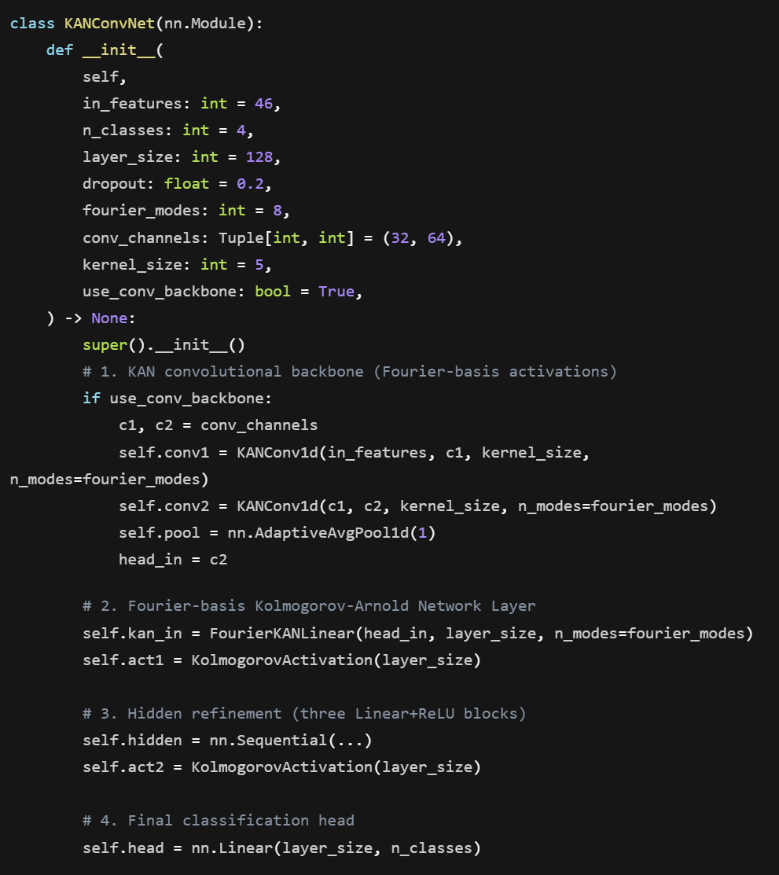
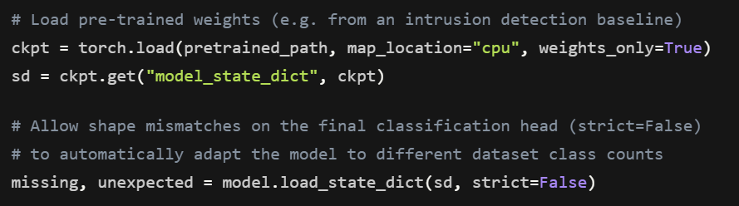
MamKANformer & Adapting Weights
Global Model Layout:
Features input modality projections, sequence stacking, stacked MamKANformer Blocks (LayerNorm, Mamba, Multi-Head Attention, B-spline KAN), average sequence pooling, followed by post-block KAN Layer 1, KAN Layer 2 (FHE Hook), KAN Layer 3, and classification head.
Loading Weights with strict=False:
The server handles bootstrap weight adaptation to match the exact class structure of the target dataset, allowing the MamKANformer model to support different output class dimensions.

Slide 12
MamKANformer Parameters Breakdown:
Total Parameters: 609,476 (CAN-VTC Configuration)
• Modality Projection Heads: 2,944 parameters
• MamKANformer Blocks Stack: 251,136 parameters
- Mamba SSM Sub-layer
- Multi-Head Self-Attention Sub-layer
- B-spline KAN Sub-layer
• Post-Block KAN Layers (Layer 1, 2, 3): 352,512 parameters
• Classification Readout: 516 parameters

Slide 13
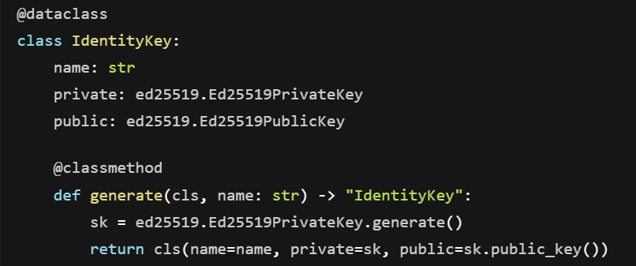
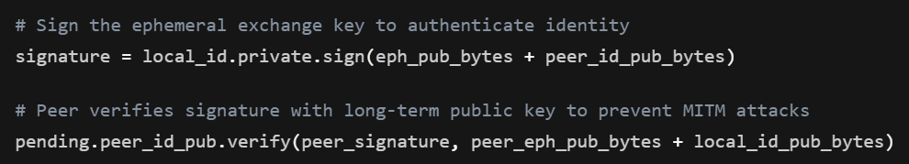
Homomorphic FHE Cryptography
CKKS Homomorphic Encryption Scheme:
Supports additions and scalar multiplications directly on real-numbered ciphertext vectors. The private key remains secure on the client (vehicle) and is never transmitted to the server.
Full-Model FHE Processing:
Weights of all layers are flattened, encrypted as a SimulatedCKKSVector, and sent. The server performs aggregation on the ciphertexts directly, maintaining zero plaintext exposure.

Slide 14
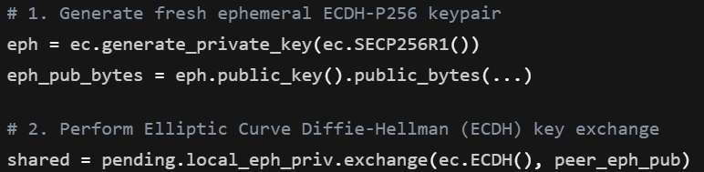
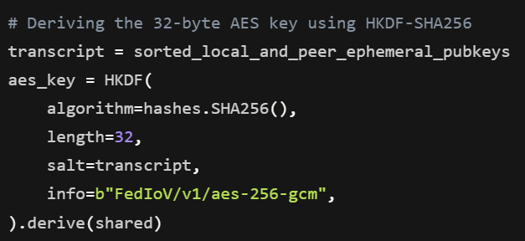
Homomorphic Aggregation & Outlier Filtering
Homomorphic FedAvg Aggregation:
Aggregates updates by evaluating additions and scalar weights homomorphically:
Enc(W_global) = sum( w_i * Enc(W_i) )
Decryption is done locally on vehicles using the FHE private key.
Homomorphic Multi-Krum Outlier Rejection:
Aggregator server computes Euclidean distances between the encrypted weight updates to run scoring and filter out Byzantine clients before aggregation, protecting against model poisoning attacks.
End-to-End Privacy: No transport keys or AES; security is guaranteed by FHE mathematical bounds.

Slide 15
Optimization Setup (Genetic Algorithm)
Purpose: Prepares the system for robust, privacy-preserving federated training across a vehicle fleet.
• Simulation Grid Setup: Dirichlet concentration (alpha = 0.3), sharding the dataset non-IID.
• Client Settings: N = 10 simulated vehicle nodes, local epochs E = 1 per round, client sampling rate q = 70%.
• Optimizer Config: AdamW optimizer, batch size = 96, learning rate = 5e-4.
• Security Context: Simulated CKKS vector context representing FHE encryption.

Slide 16
Integrity Verification & Phase Boundaries
Homomorphic Aggregation & Validation:
• Server aggregates FHE ciphertexts homomorphically.
• Clients receive global ciphertext and decrypt it using their private keys.
• Integrity Check: Reconstructed weights match mathematical expectations, verifying zero-loss encryption.
Complete FHE Simulation (Phase 2):
• Centralized transport key handshakes (AES/ECDH) are fully deprecated.
• Simulated federated rounds are executed sequentially across all 4 target datasets.
• Results compiled into a simulation report.

Slide 17
Proof of Work & Smoke Test Results
System Sanity Check:
• FHE Aggregation Time: Completed in ~4.5s to 99.8s depending on dataset size.
• Outlier Rejection: Multi-Krum successfully filtered out Byzantine nodes.
Multi-Round Federated FHE Performance (3 Rounds):
• CAN-VTC: 64.29% Accuracy | 0.9953 ROC-AUC
• Car-Hacking: 35.71% Accuracy | 0.9026 ROC-AUC
• CICIDS-2017: 99.58% Accuracy | 0.9465 ROC-AUC
• VeReMi: 73.81% Accuracy | 0.5188 ROC-AUC (Reflects early round non-IID training)

